Slide 1

Sales Promotion Strategy and Forecasting
Deepalakshmi
Master Of Data Analytics
Data Gyan

Slide 2

Tables Contents
Introduction
Scope of Project
Tools to be used
Suggestions
Advantages
Disadvantages
Conclusions

Slide 3

Introduction
Sales promotion is a marketing strategy where the product is promoted using short-term attractive initiatives to stimulate its demand and increase its sales. Sales promotion is a handy technique to fulfil short-term sales goals by persuading potential customers to buy the product. Sales promotion strategy involves planning and implementing activities to boost the sales of a product or service. It's like giving your sales a little extra push. Common tactics include discounts, coupons, contests, and product bundling. The key is to create a sense of urgency and excitement among customers.
Sales forecasting is one of the most important things a company does. It fuels sales planning and is used throughout an enterprise for staffing and budgeting. Despite its importance, many organizations use outmoded practices that produce bad forecasts.

Slide 4

Project Scope
Project scope is everything that’s needed to complete a project, including tasks, time, and resources. So, project scope management the process of overseeing and regulating all of those things so that you can complete your project.
Effective project scope management helps you stick as closely as possible to your original plan and manage your resources more effectively.
Steps for defining project scope
1. Define the project’s goals
2. Define the project’s deliverables
3. Define the project’s tasks and activities

Slide 5

Dataset Brief
1. Customer ID
2. First Name
3. Last Name
4. Full Name
5. Gender
6. Mode Of Purchase
7. Past 3 Years Bike Related Purchases
8. DOB
9. Age
10.Brand
11.Product Type
12.Product Class
13.Job Title
14.Job Industry Category
15Wealth Segment
16Owns Car
17.Tenure
18.Cost
19.Price
20.Profit

Slide 6

Used Tools
MS Excel- Data Cleansing
SQL server- Data Analyzing
Tableau- Data Visualization
Python- Data Analyzing
Machine Learning(ML)- Profit Forecasting

Slide 7
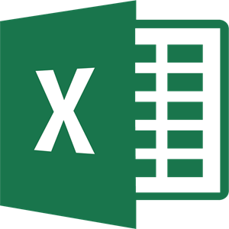
MS Excel
Microsoft Excel is a popular spreadsheet software program for business. It's used for data entry and management, charts and graphs, and project management. You can format, organize, visualize, and calculate data with this tool.

Slide 8
Data Cleansing
Data cleansing, also referred to as data cleaning or data scrubbing, is the process of fixing incorrect, incomplete, duplicate or otherwise erroneous data in a data set. It involves identifying data errors and then changing, updating or removing data to correct them. Data cleansing improves data quality and helps provide more accurate, consistent and reliable information for decision-making in an organization.

Slide 9
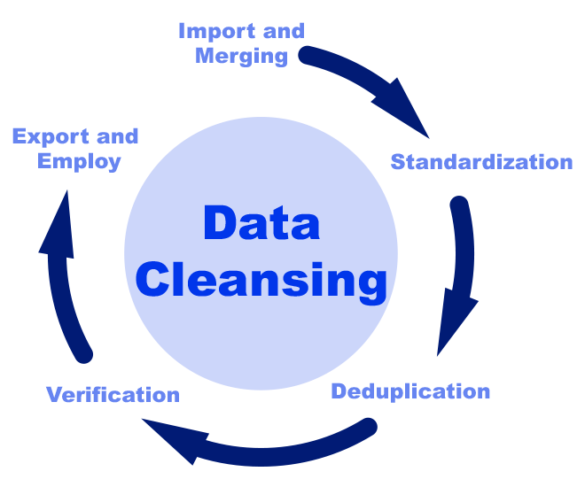

Slide 10
DBMS
A Database Management System (DBMS) is a software system that is designed to manage and organize data in a structured manner. It allows users to create, modify, and query a database, as well as manage the security and access controls for that database.
A database management system (DBMS) is system software for creating and managing databases. A DBMS makes it possible for end users to create, protect, read, update and delete data in a database.

Slide 11
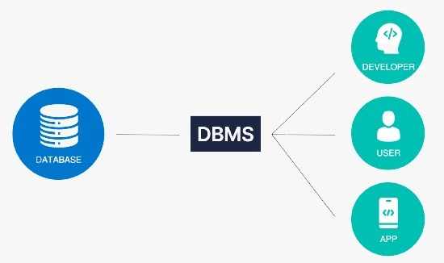

Slide 12
rdbms
A relational database management system (RDBMS) is a program used to create, update, and manage relational databases. Some of the most well-known RDBMSs include MySQL, PostgreSQL, MariaDB, Microsoft SQL Server, and Oracle Database.
RDBMS stands for Relational Database Management Systems. It is basically a program that allows us to create, delete, and update a relational database. A Relational Database is a database system that stores and retrieves data in a tabular format organized in the form of rows and columns.

Slide 13
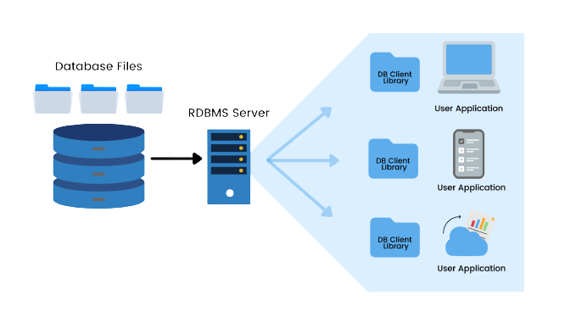

Slide 14
Data manipulation
Data manipulation is the process of organizing or arranging data in order to make it easier to interpret. Data manipulation typically requires the use of a type of database tools called data manipulation tools . Data Manipulation Tools is a type of Query, Formula, Code etc. that allows you to reorganize data by modifying it within its database program. Here we have used for data manipulation tools as follows:
SQL Server Management Studio MS Excel Tableau Python

Slide 15
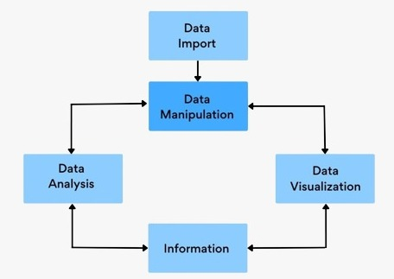

Slide 16
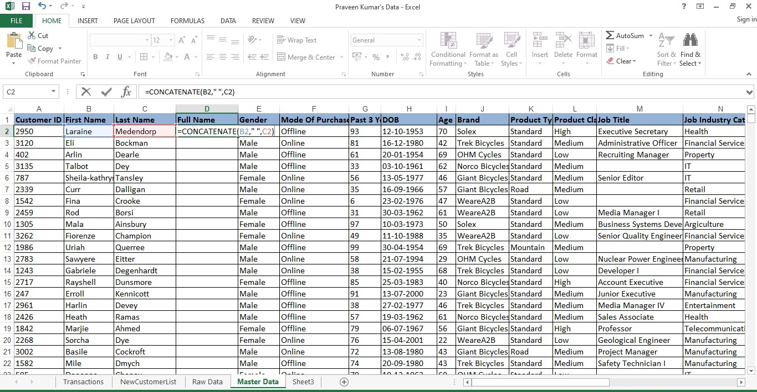
Concatenate
The word CONCATENATE means to join or combine. The CONCATENATE function in Excel is used to combine the text from different cells into one cell.
Formula =CONCATENATE(B2," ",C2)

Slide 17
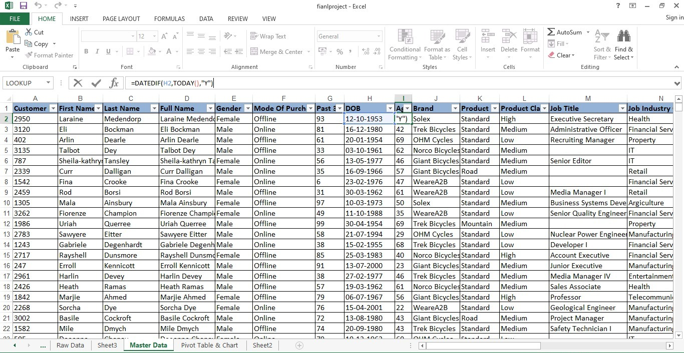
Age
To calculate the age of a person in Excel, use DATEDIF and TODAY. The DATEDIF function has three arguments. Enter the date of birth into cell A2.
Formula= DATEDIF(H2,TODAY(),"Y")

Slide 18
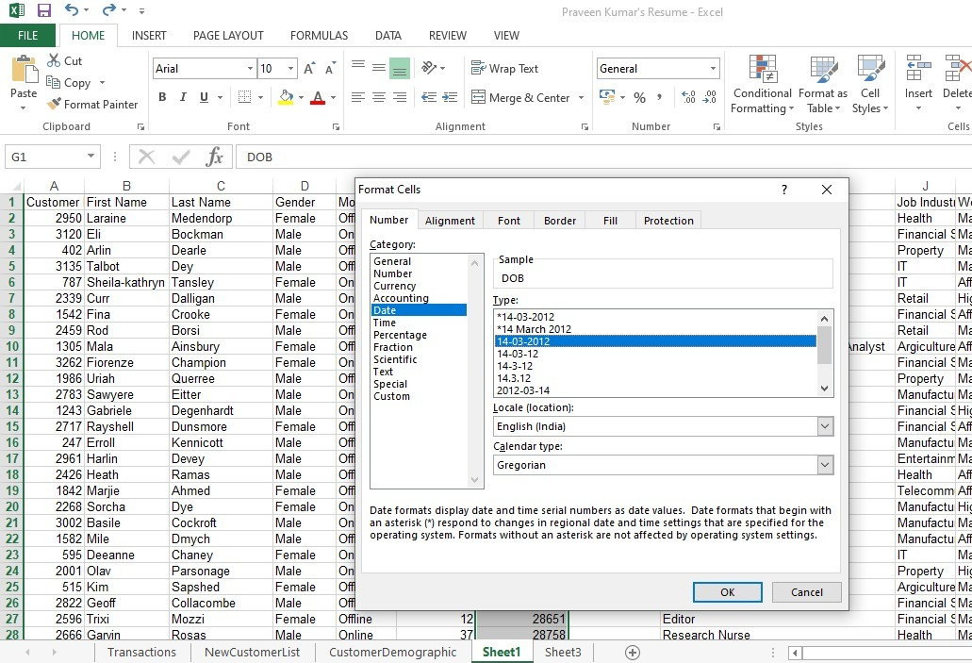
Format
This formula returns a number value, then you can convert the number to a date format as you need.

Slide 19
Lookup
Use the LOOKUP function to look up a value in a one-column or one-row range, and retrieve a value from the same position in another one-column or one-row range.
Formula= LOOKUP(A2,Rawdata!A1:$Y$20001,Rawdata!$L$19874:$L$20001)

Slide 20
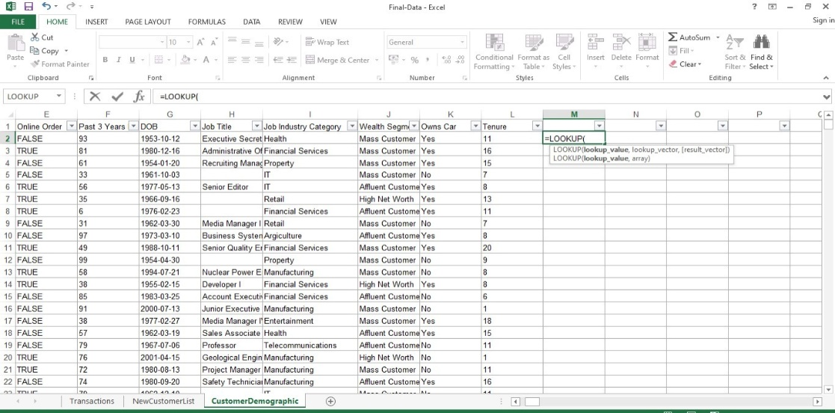
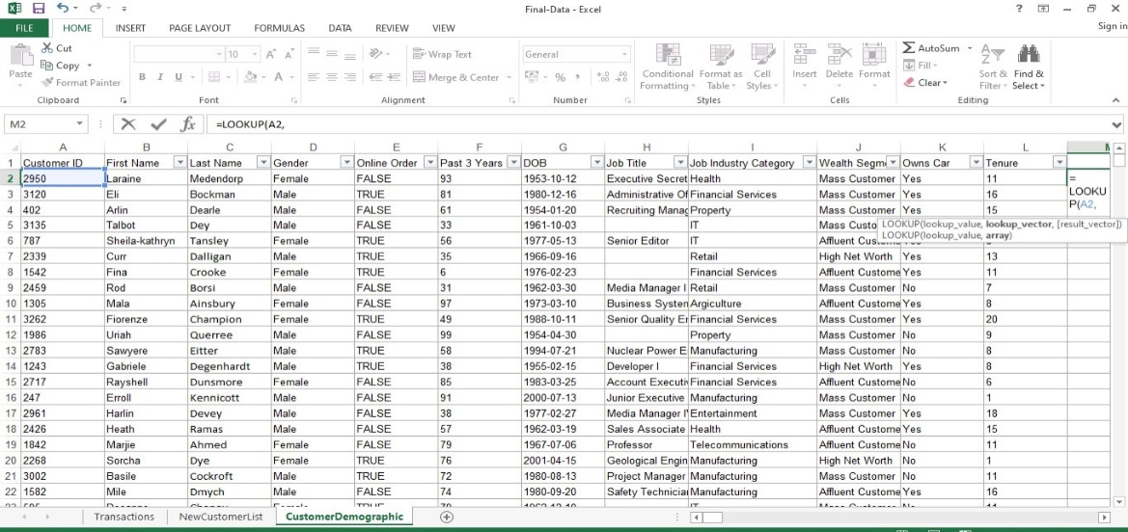
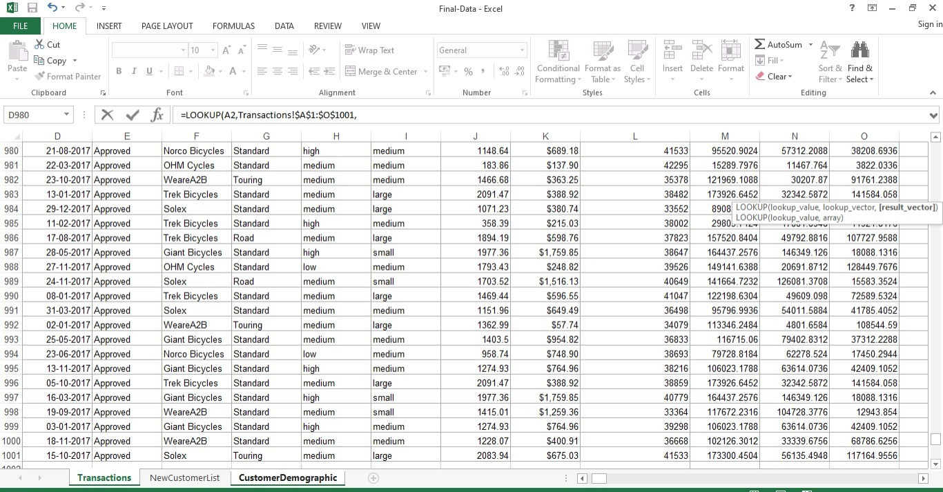

Slide 21
Conditional Formatting
Conditional formatting is used to change the appearance of cells in a range based on your specified conditions.
The conditions are rules based on specified numerical values or matching text.
Select the cells you want to apply conditional formatting to. Click the first cell in the range, and then drag to the last cell.
Click HOME > Conditional Formatting > Highlight Cells Rules > Text that Contains. ...
Select the colour format for the text, and click OK.

Slide 22
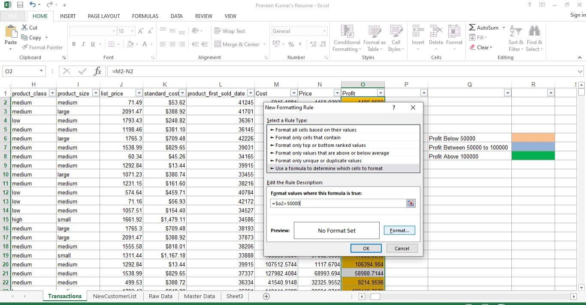
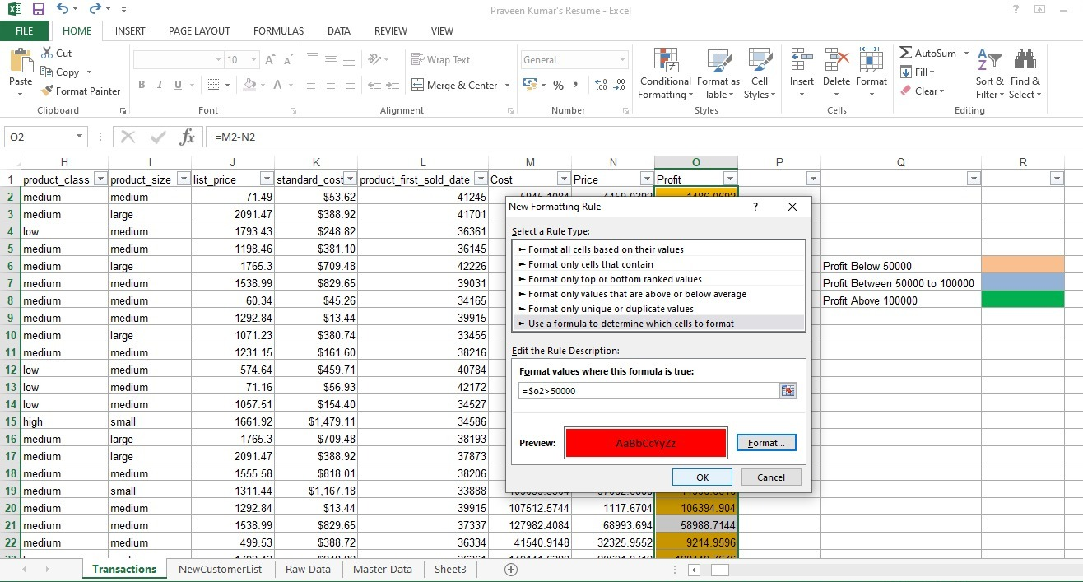
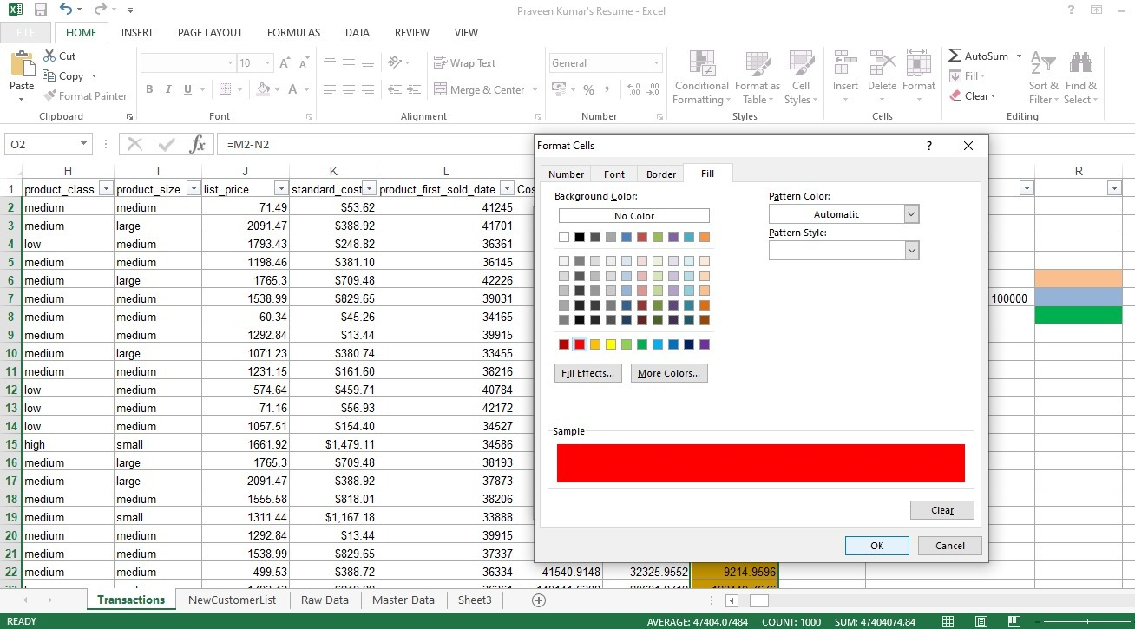
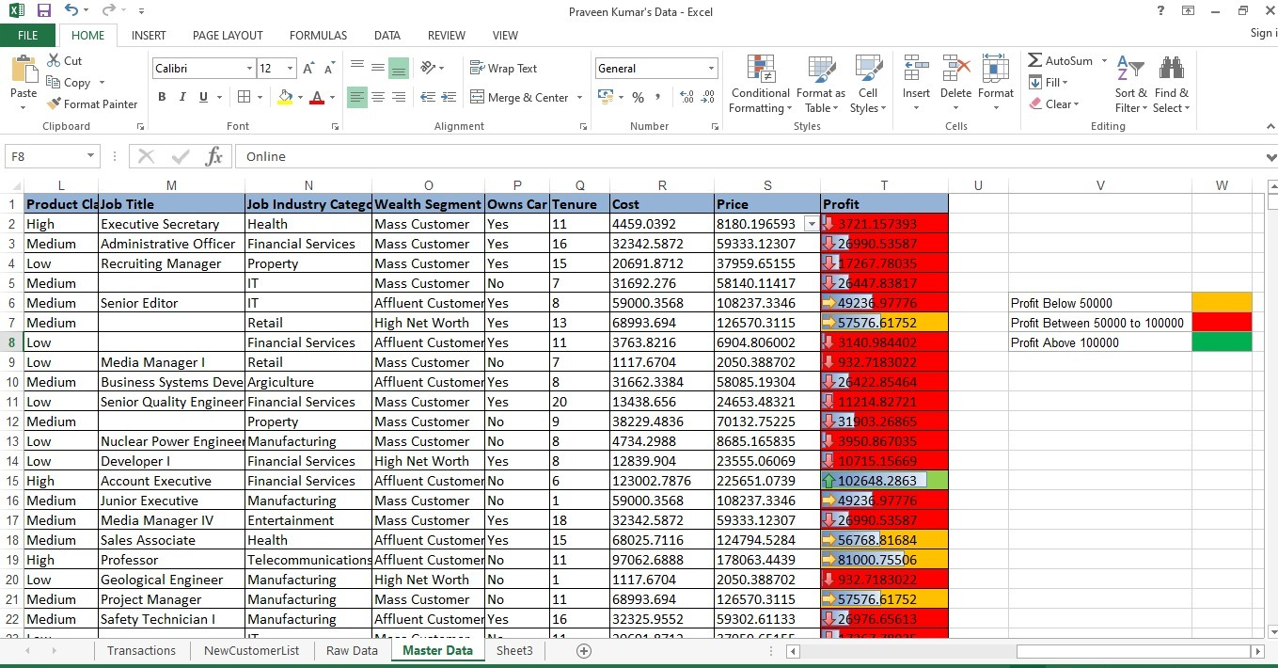

Slide 23
Replace
The REPLACE Function is categorized under Excel TEXT functions. The function will replace part of a text string, based on the number of characters you specify, with a different text string.
Press Ctrl+H or go to Home > Find & Select > Replace.
In Find what, type the text or numbers you want to find.
You can further define your search: ...
In the Replace with box, enter the text or numbers you want to use to replace the search text.
Select Replace or Replace All.

Slide 24
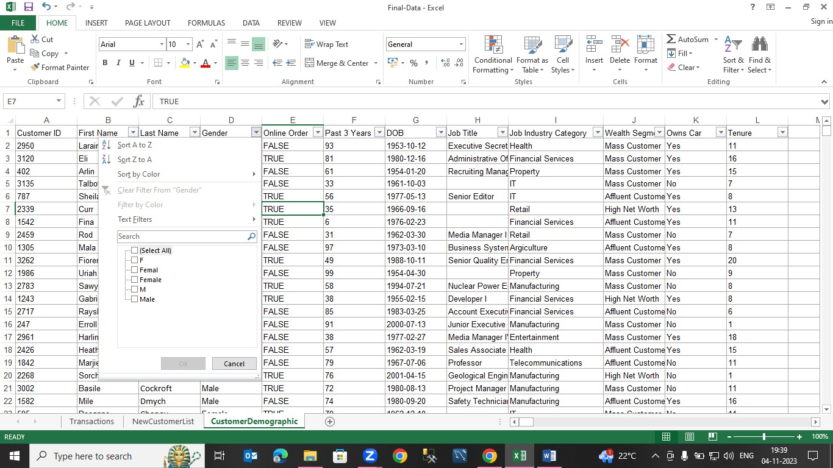
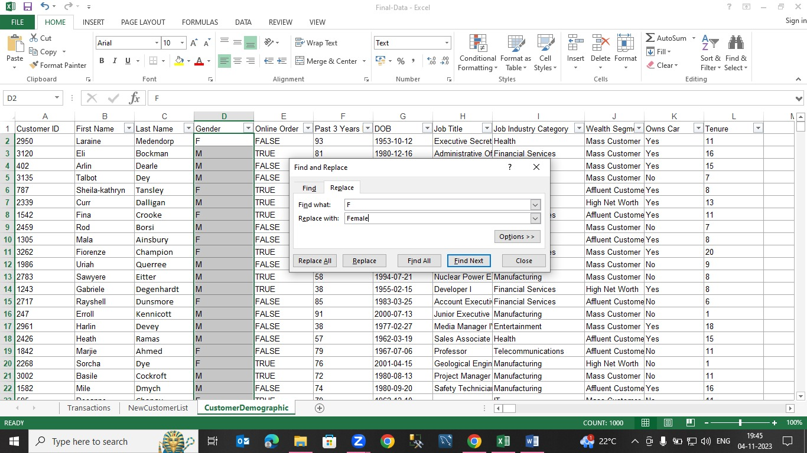
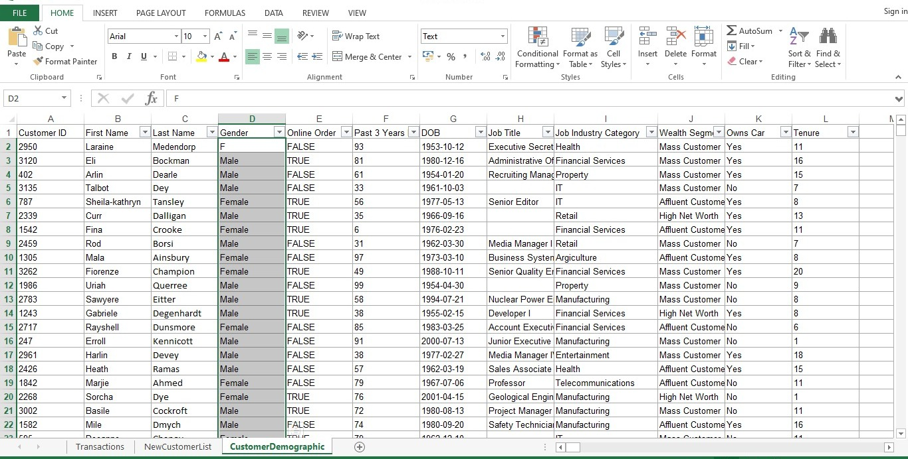

Slide 25
Pivot Table In Excel
Pivot tables are among the most useful and powerful features in Excel. We use them in summarizing the data stored in a table. They organize and rearrange statistics (or "pivot") to draw attention to the valuable facts. You can take an extremely large data set and see the relevant information you need in a clean, concise, manageable way.
Select a cell in the source data or table range.
Go to Insert > PivotTable.
Excel displays the Create PivotTable dialog box with your range or table name selected.
In the Choose where you want the PivotTable report to be placed section, select New Worksheet, or Existing Worksheet.

Slide 26
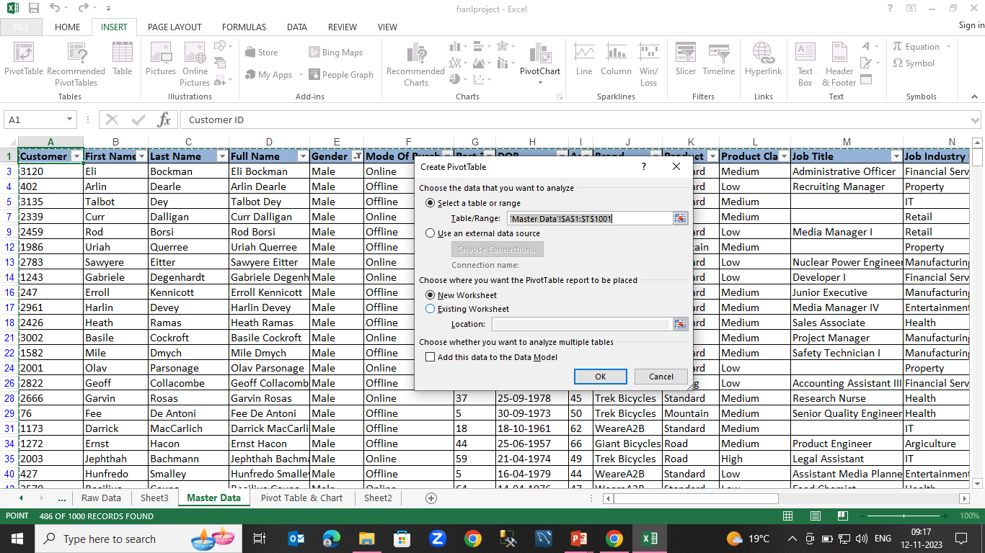
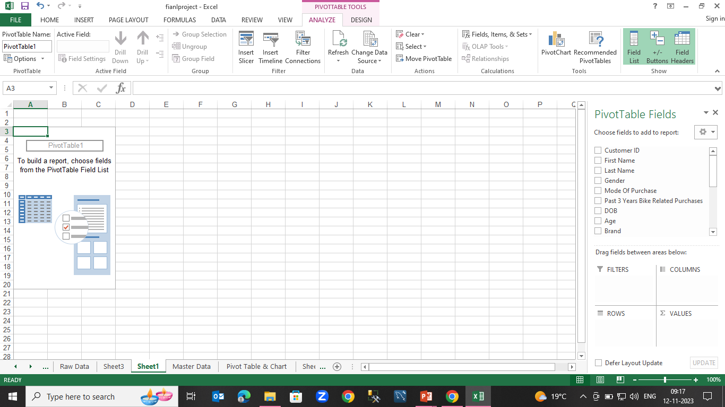
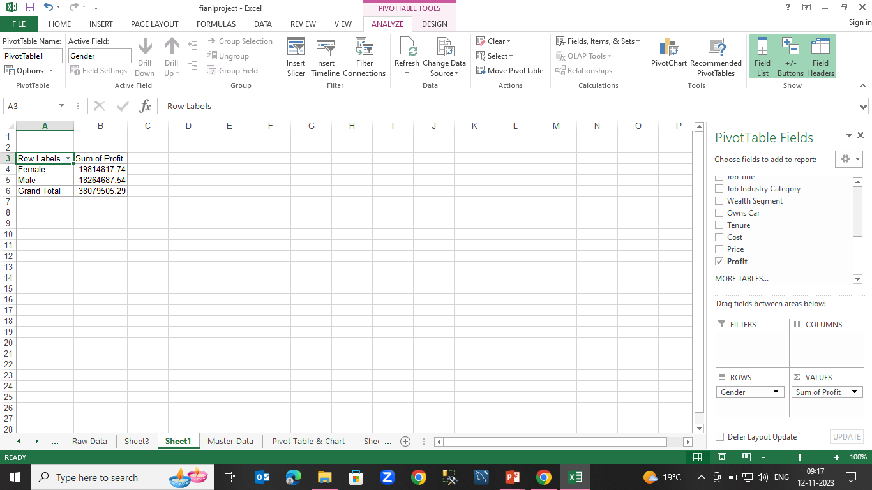

Slide 27
Pivot chart
Pivot charts are used to graphically summarize the data and explore complicated data.
A Pivot chart shows the data series, categories, and chart axes the same way a standard chart does. Additionally, it also gives you interactive filtering controls right on the chart so that you can quickly analyze a subset of your data.
Select a cell in your table.
Select Insert > PivotChart .
Select where you want the PivotChart to appear.
Select OK.
Select the fields to display in the menu.

Slide 28
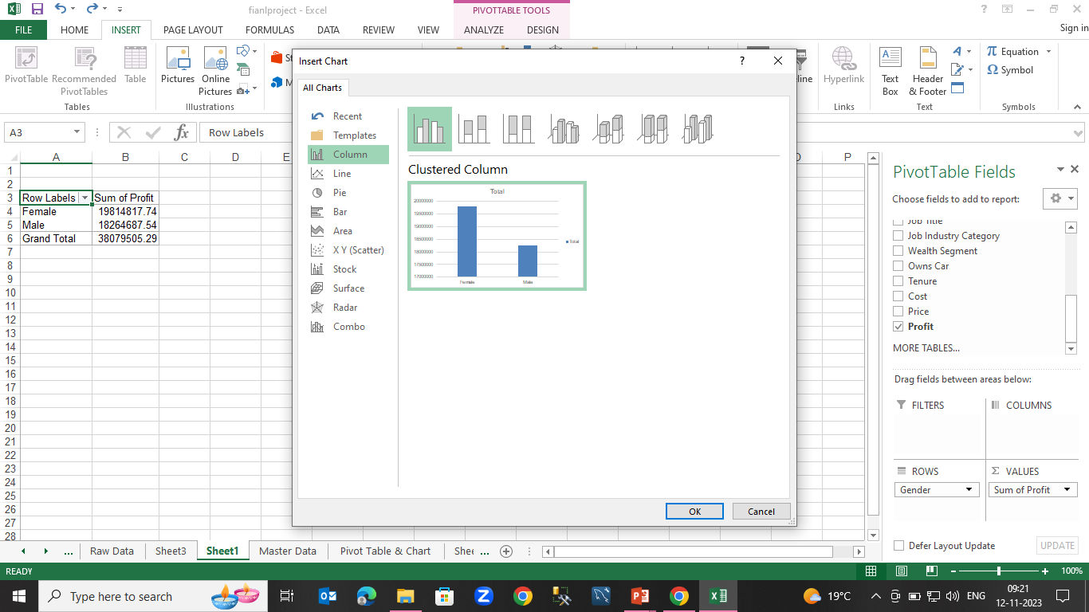
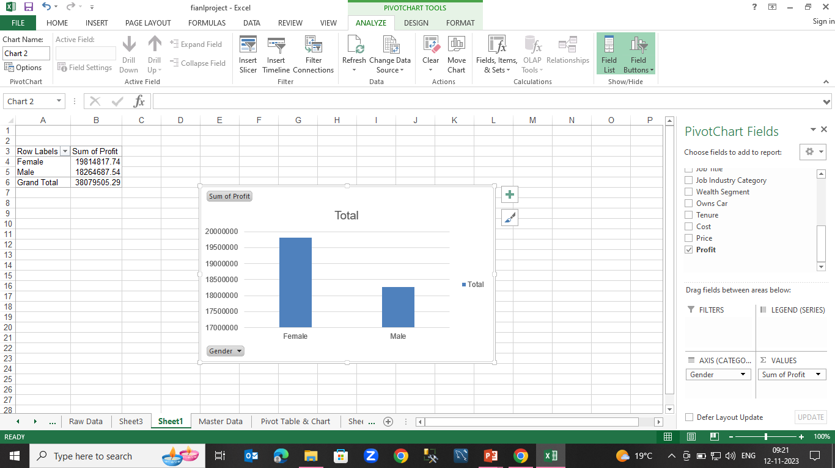

Slide 29
Gender wise Profit
Row Labels | Sum of Profit
Female | 19814817.74
Male | 18264687.54
Grand Total | 38079505.29

Slide 30
Mode Of Purchase
Row Labels | Sum of Profit
Offline | 20913988.6
Online | 17165516.68
Grand Total | 38079505.29

Slide 31
Age wise Profit
Row Labels | Sum of Profit
21-30 | 5696421.761
31-40 | 6353642.864
41-50 | 14049384.24
51-60 | 6208235.478
61-70 | 5720026.623
Grand Total | 38027710.97

Slide 32
Brand Wise Profit
Row Labels | Sum of Profit
Giant Bicycles | 10822005.3
Norco Bicycles | 5689220.46
OHM Cycles | 4888612.752
Solex | 7039312.524
Trek Bicycles | 5153243.125
WeareA2B | 4487111.131
Grand Total | 38079505.29

Slide 33
Product type wise profit
Row Labels | Sum of Profit
Mountain | 779357.9366
Road | 9293959.257
Standard | 25987995.79
Touring | 2018192.302
Grand Total | 38079505.29

Slide 34
Product Class wise profit
Row Labels | Sum of Profit
High | 11278955.94
Low | 3896916.33
Medium | 22903633.02
Grand Total | 38079505.29

Slide 35
Customer’s job category wise profit
Row Labels | Sum of Profit
Argiculture | 2309849.81
Entertainment | 1872132.883
Financial Services | 8117679.359
Health | 6970001.612
IT | 2735291.497
Manufacturing | 8566399.909
Property | 2684534.364
Retail | 3836617.37
Telecommunications | 986998.4823
Grand Total | 38079505.29

Slide 36
Customer’s wealth segment
Row Labels | Sum of Cost | Sum of Profit
Affluent Customer | 11216066.12 | 9360031.501
High Net Worth | 11527754.4 | 9620141.605
Mass Customer | 22886608.09 | 19099332.18
Grand Total | 45630428.61 | 38079505.29

Slide 37
Customer’s own car
Row Labels | Count of Customer
No | 513
Yes | 487
Grand Total | 1000

Slide 38
Excel Forecasting
If you have historical time-based data, you can use it to create a forecast. When you create a forecast, Excel creates a new worksheet that contains both a table of the historical and predicted values and a chart that expresses this data. A forecast can help you predict things like future sales, inventory requirements, or consumer trends.
Formula= FORECAST(V14,T2:T1001,R2:R1001)

Slide 39
Excel Forecasting Table and chart
Forecast
Cost | Profit
72190 | 60243.9988
57917 | 48332.89484
88110 | 73529.5572
124500 | 103897.74
94300 | 78695.236

Slide 40
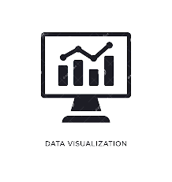
Excel visualization
Data visualizations in Excel are representations of numerical data in a visual format. You can organize data in a spreadsheet into a more accessible and organized format like a line graph, Gantt chart or bar graph.

Slide 42
Excel Dashboard
The Excel Dashboard is used to display overviews of large data tracks. Excel Dashboards use dashboard elements like tables, charts, and gauges to show the overviews. The dashboards ease the decision-making process by showing the vital parts of the data in the same window.

Slide 43
Excel Slicer
Slicers provide buttons that you can click to filter tables, or PivotTables. In addition to quick filtering, slicers also indicate the current filtering state, which makes it easy to understand what exactly is currently displayed.
To insert a slicer, execute the following steps.
1. Click any cell inside the pivot table.
2. On the PivotTable Analyze tab, in the Filter group, click Insert Slicer.
3. Check Country and click OK.
4. Click United States to find out which products we export the most to the United States.
5. Click any cell inside the pivot table.
6. On the PivotTable Analyze tab, in the Filter group, click Insert Slicer.

Slide 44
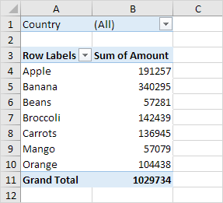
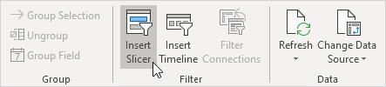
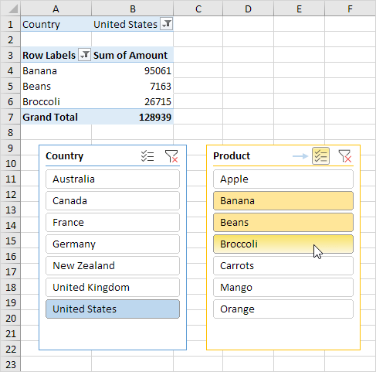

Slide 45
Excel dash board inter connections
To connect your Excel sheet on SharePoint to your dashboard, you can follow these steps: Open your dashboard and select the data source as Excel. Choose the option to connect to an existing file.
To connect both slicers to this pivot table, execute the following steps.
1. Select the first slicer.
2. On the Slicer tab, in the Slicer group, click Report Connections.
3. Select the second pivot table and click OK.

Slide 46
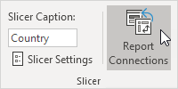
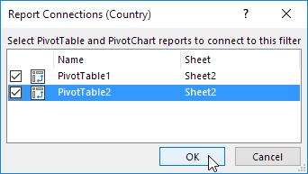
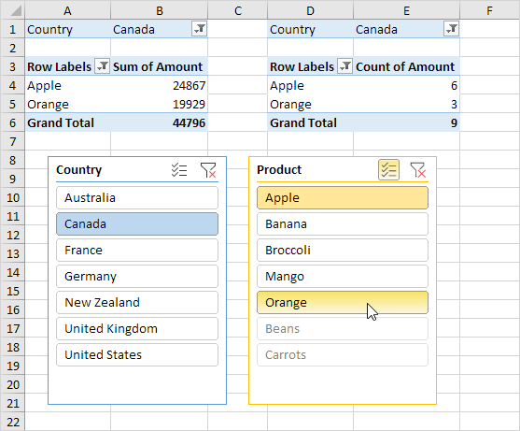

Slide 47
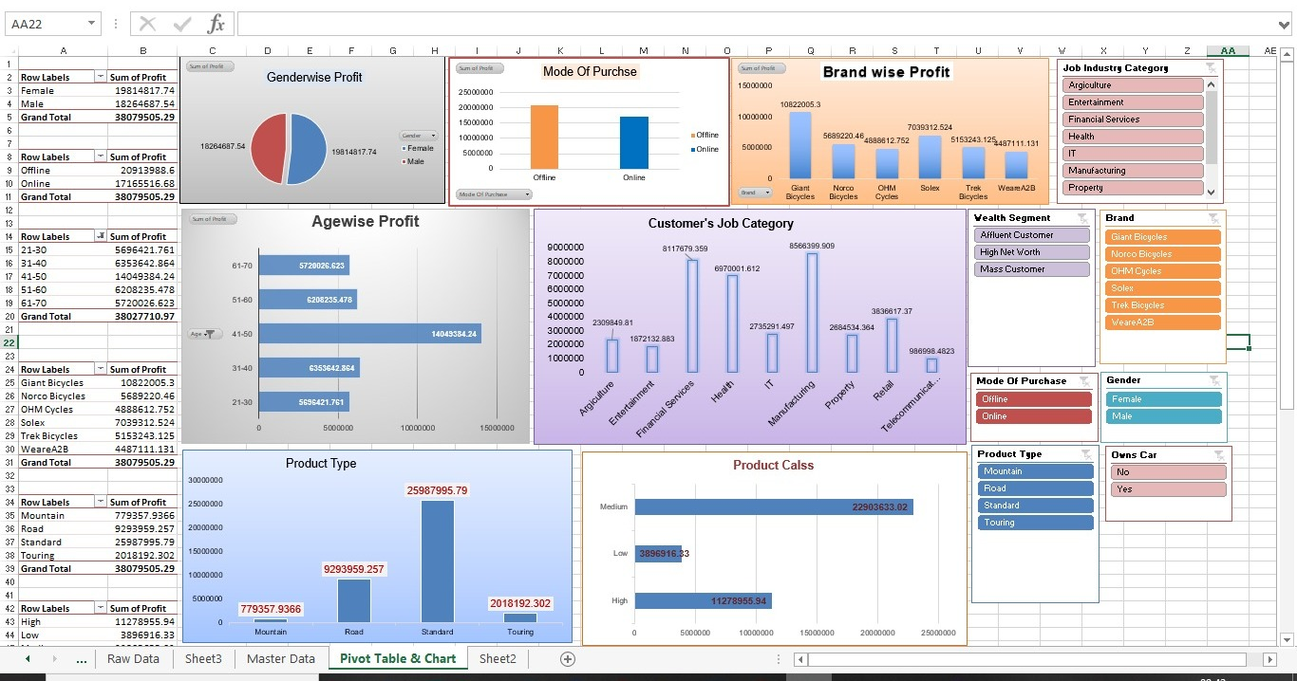

Slide 48

Microsoft SQL Server
Microsoft SQL Server is a proprietary relational database management system developed by Microsoft. As a database server, it is a software product with the primary function of storing and retrieving data as requested by other software applications which may run either on the same computer or on another computer across a network (including the Internet). Microsoft markets at least a dozen different editions of Microsoft SQL Server, aimed at different audiences and for workloads ranging from small single-machine applications to large Internet-facing applications with many users.

Slide 49
How to import data from an Excel file to a SQL Server database
To start the process of importing data from an Excel file to a SQL Server database using the SQL Server Import and Export Wizard the SQL Server Import and Export Wizard needs to be launched. There are several ways to do that, and this can be seen on the How to import/export data to SQL Server using the SQL Server Import and Export Wizard page

Slide 50
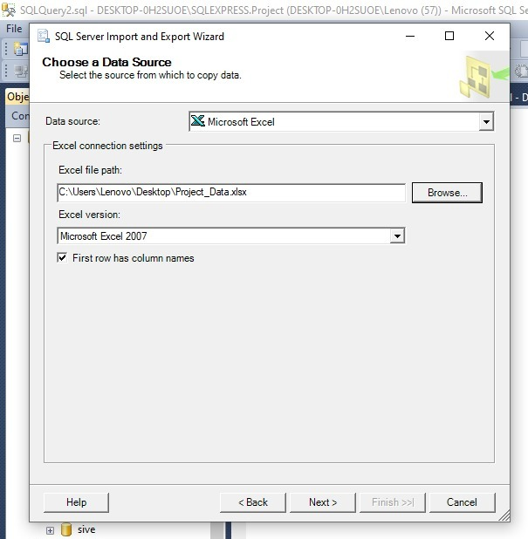
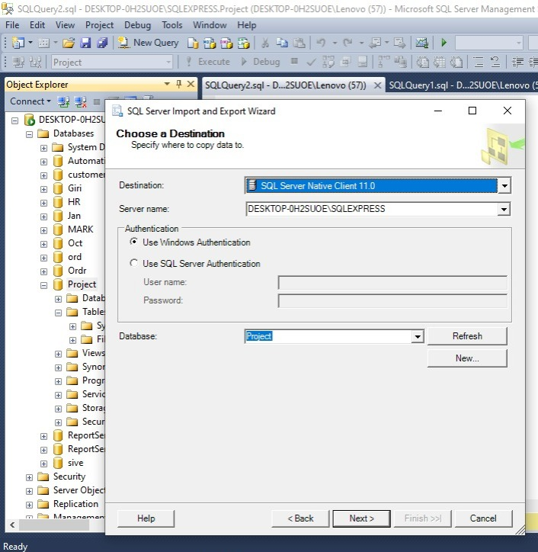
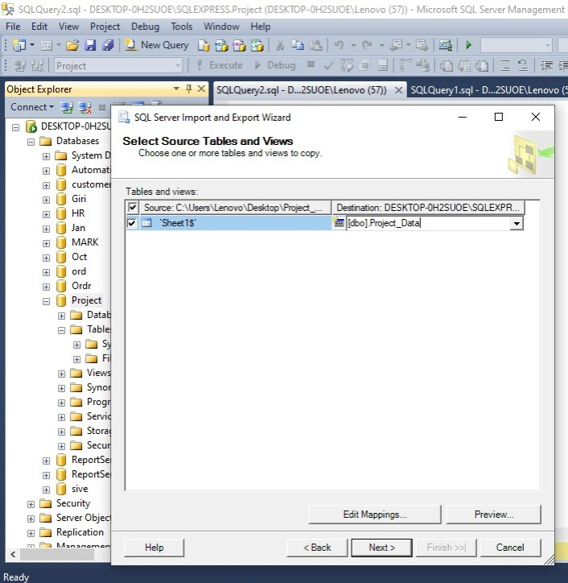
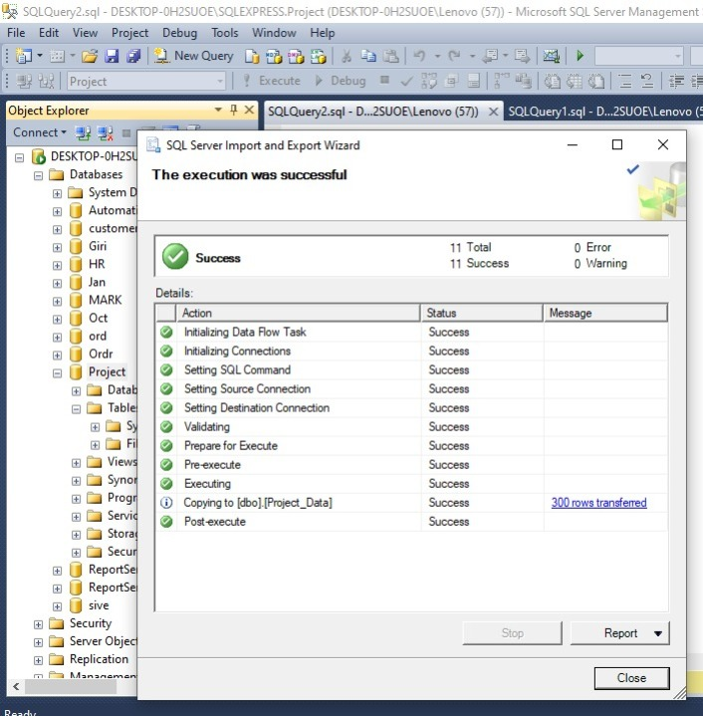
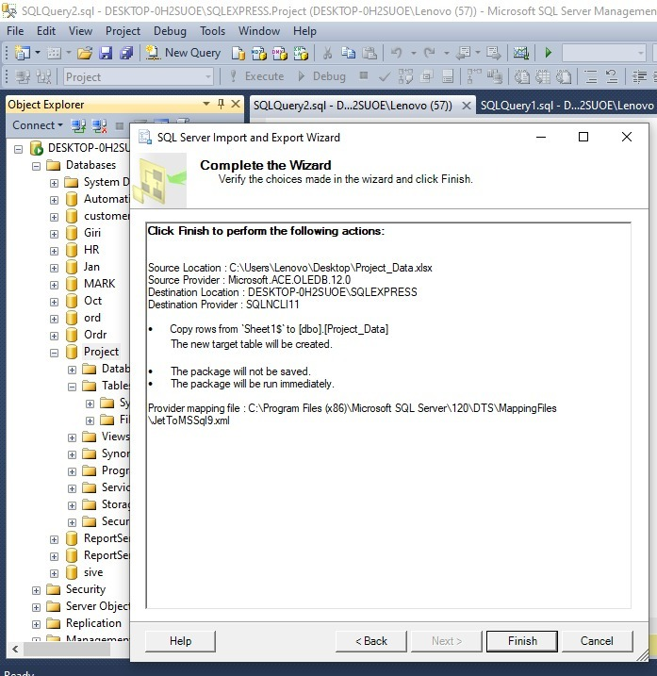
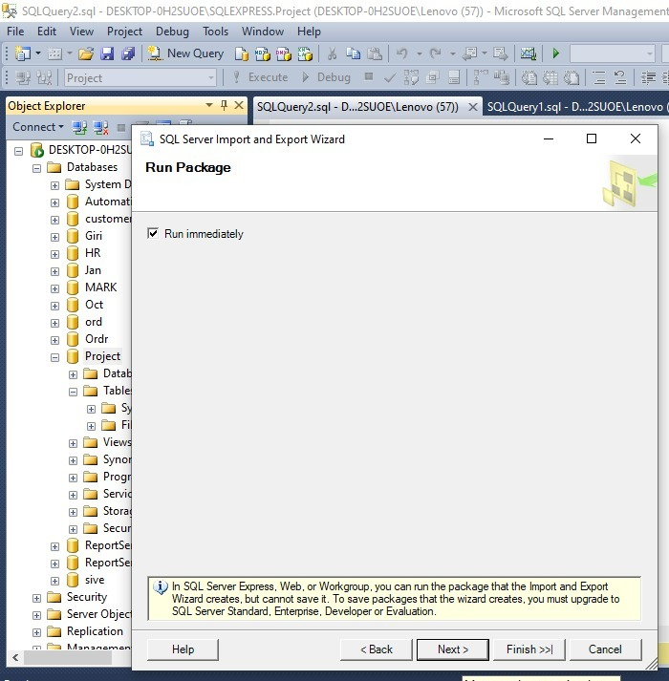

Slide 51
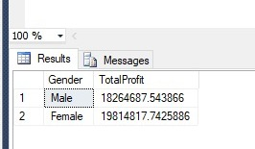
Gender wise profit
select Gender, sum(Profit) as TotalProfit from ProjectData group by Gender;

Slide 52
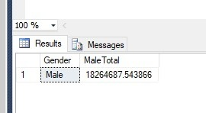
Find out male total
select Gender, sum(Profit) as MaleTotal from ProjectData group by Gender having gender='Male';

Slide 53
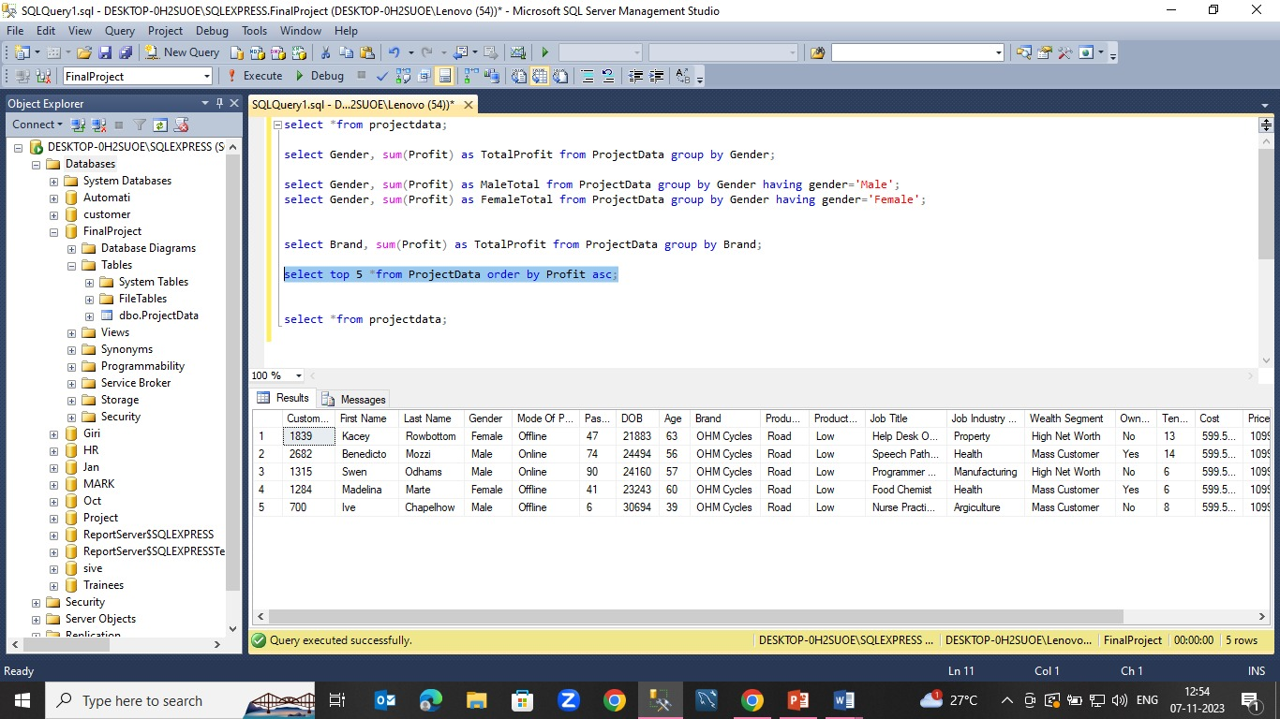
Top 5 Profit Order by
select top 5 *from ProjectData order by Profit asc;

Slide 54
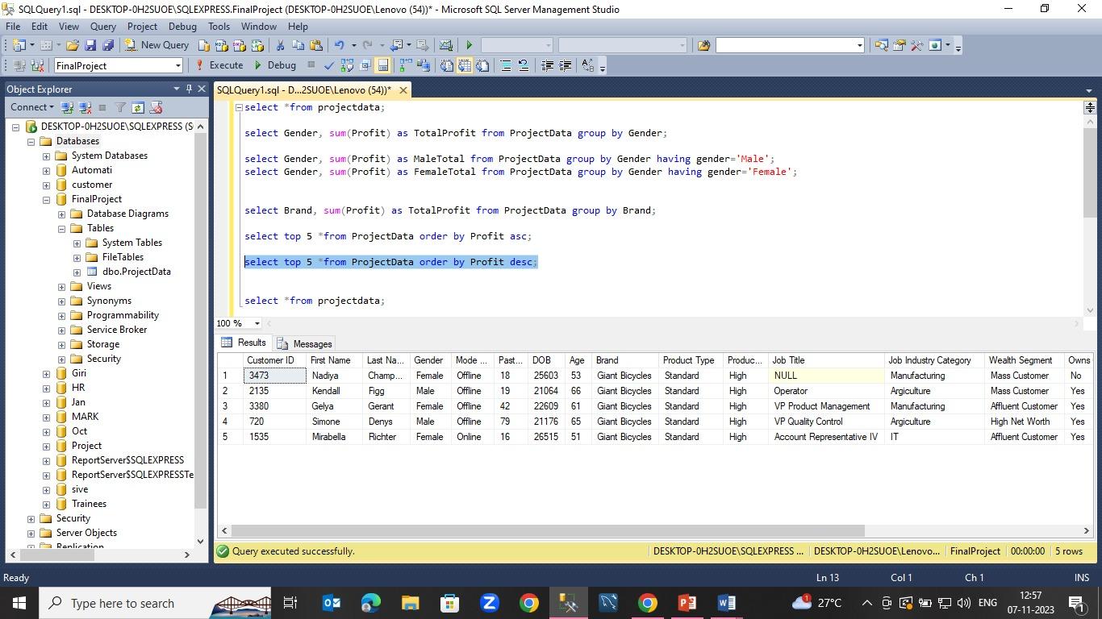
Top least 5 profit
select top 5 *from ProjectData order by Profit desc;

Slide 55
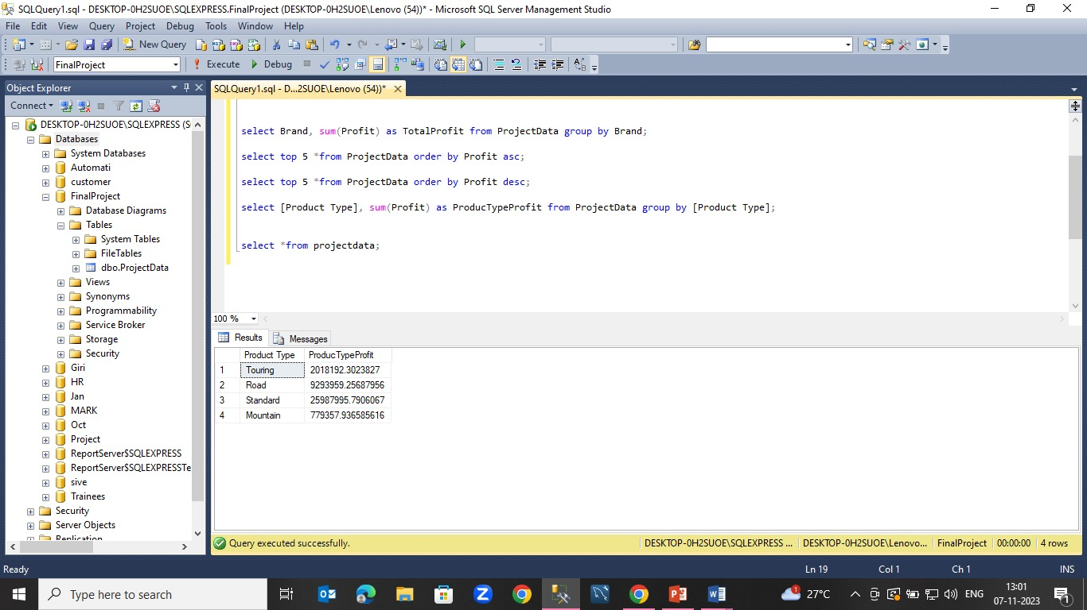
Product Type Wise Profit
select [Product Type], sum(Profit) as ProducTypeProfit from ProjectData group by [Product Type];

Slide 56
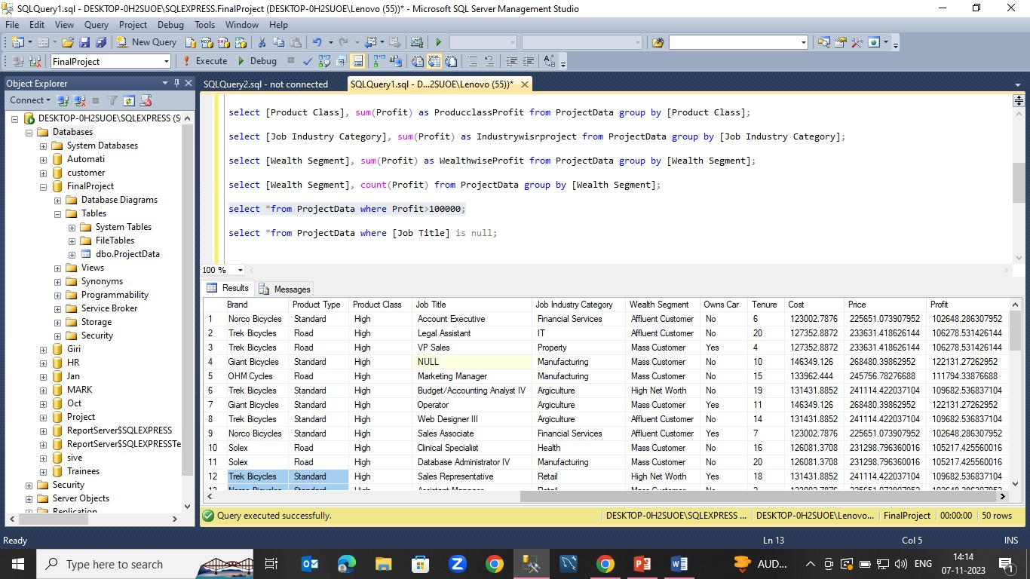
Retrieve more than 100000 profit
select *from ProjectData where Profit>100000;

Slide 57
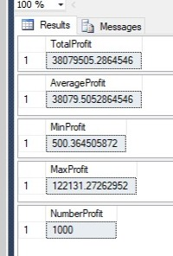
sql aggregate functions
select Sum(Profit) TotalProfit from ProjectData;
select Avg(Profit) AverageProfit from ProjectData;
select Min(Profit) MinProfit from ProjectData;
select Max(Profit) MaxProfit from ProjectData;
select count(Profit) NumberProfit from ProjectData;

Slide 58

Machine learning prediction
“Prediction” refers to the output of an algorithm after it has been trained on a historical dataset and applied to new data when forecasting the likelihood of a particular outcome, such as our revenue based upon cost. The algorithm will generate probable values for an unknown variable for each record in the new data, allowing the model builder to identify what that value will most likely be.

Slide 59
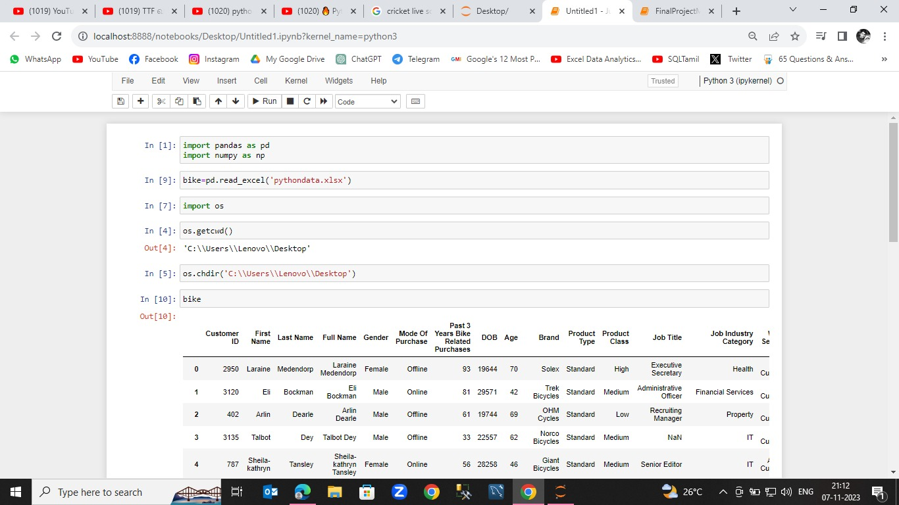
Excel Import to python

Slide 60
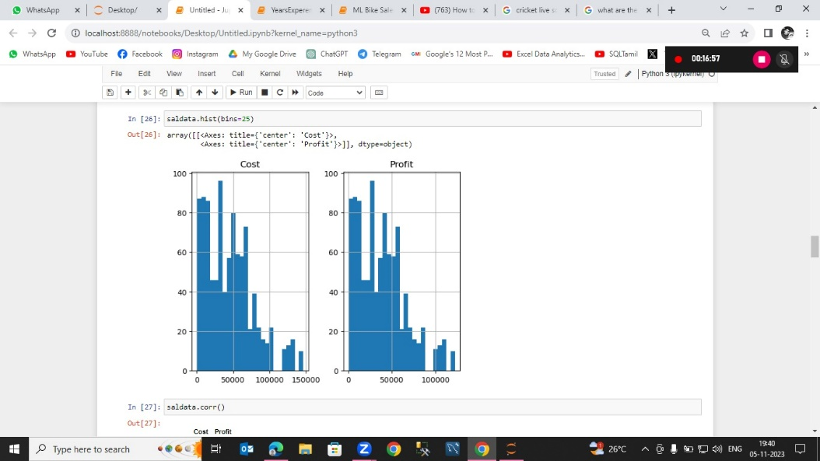
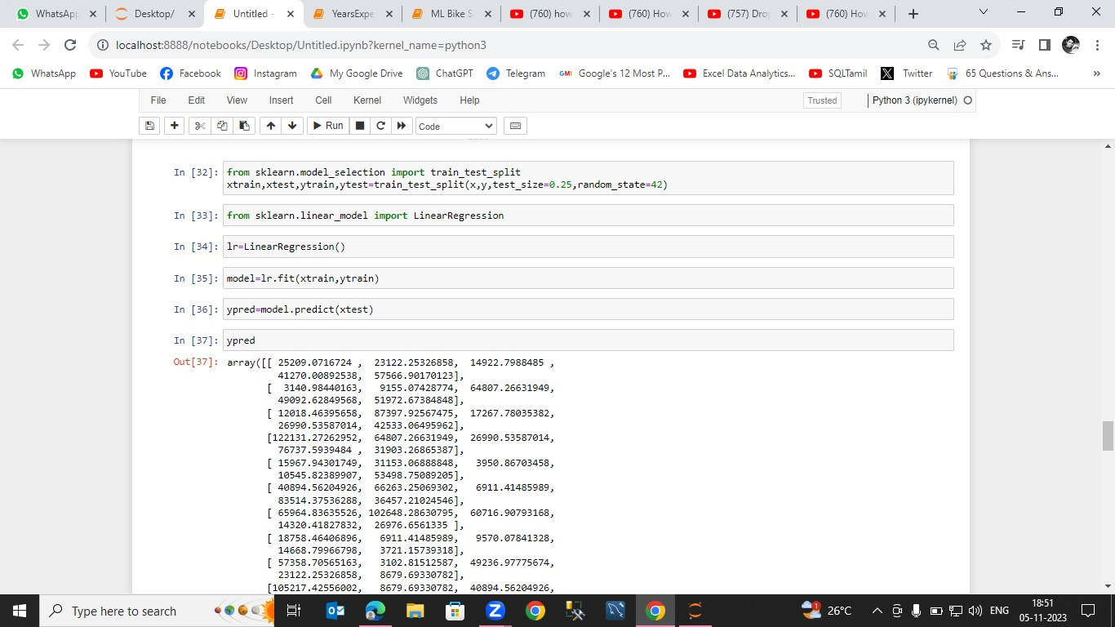

Slide 61
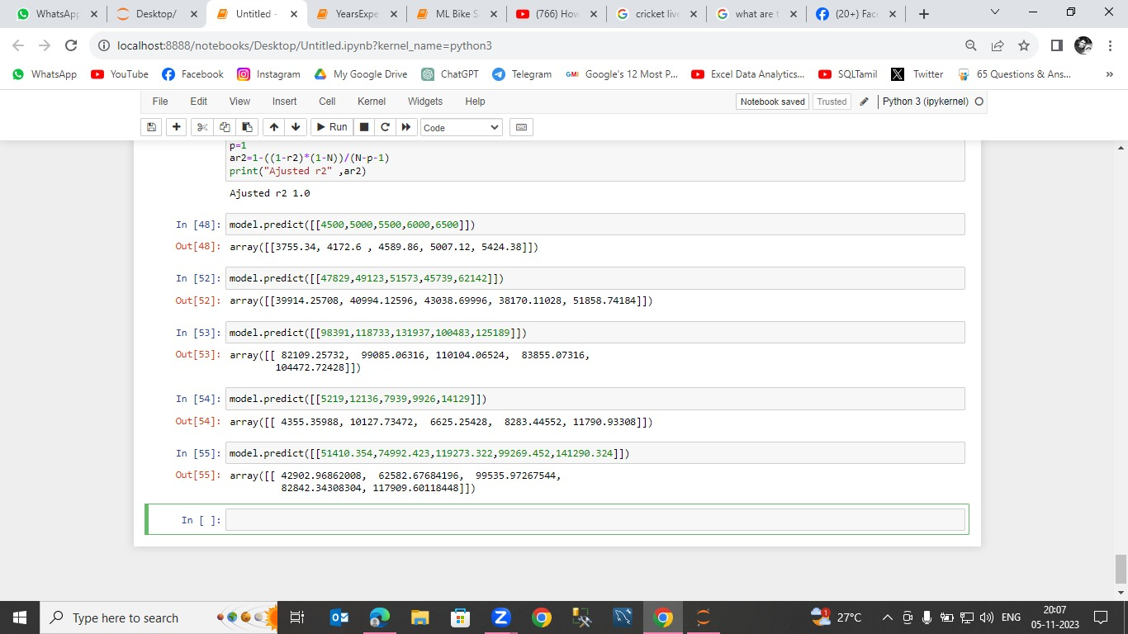

Slide 62

Tableau
Tableau is Business Intelligence Software That Helps People See And Understand Their Data. Transform Data into Actionable Insights with Tableau. Get Your Free Trial Now! Interactive Reports. Drag & Drop. Free Training. Fast & Simple Analytics.

Slide 63
import data to tableau
Open the Tableau tool.
Click the “Microsoft Excel” in the “To a file” of “Connect” section, ( Connect -> To a file -> Microsoft Excel.)
Select an Excel file and open it.
Here, you will get your dataset (Excel file content) with all sheets it has.

Slide 64
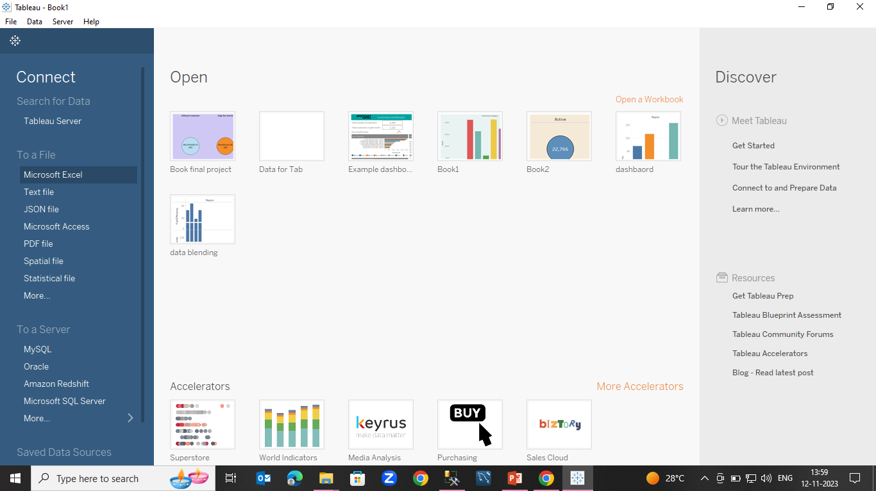
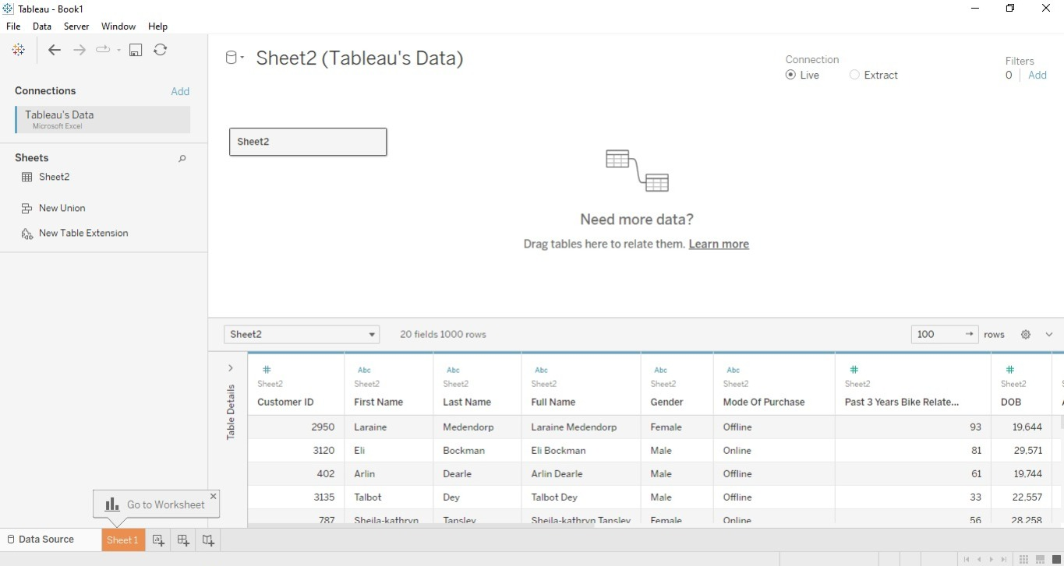

Slide 65
Tableau dashboard
Tableau is Business Intelligence Software That Helps People See And Understand Their Data. Transform Data into Actionable Insights with Tableau. Get Your Free Trial Now! Free Training. Fast & Simple Analytics. Free Trial. Connect Data Sources. Data Cleaning.

Slide 66


Slide 67

Suggestions
We should introduce some more products for male customers in a way it attracts them introduce to male because male lower than female.
As per mode of purchase online is low compare to offline first give some offer to online first we should acquire some online customer after we increase the price.
According age wise 21-30 very high these age obviously young customers hence we should make some research to try to introduce new modern style which as must attract to young people.
According product type mountain cycle sold very low give some advertisement to hills area and some interior village than we can definitely increase sales and it helps to gaining new customers.
Product classes we are selling three types High, medium and low. Low level product sold minimum quantity so we need some changes to low level product first we capture the market then we slowly increase the price.
As per this research we give some important weareA2B, norco bicycles and ohm cycles.
According to customer’s job category our product capture only some middle class customer we bring some invention to our product to attract to rich people .

Slide 68
We should give important to advertisement and give some offers to attract to customer first gain customer after we increase price and we can easily capture the potentials customers.
We make some marketing some strategies these are attract urban areas and especially village areas , hills and those are living near by mountain areas. Because mountain people mostly some middle class people our product should attract those particular people then we attaining more profit.

Slide 69
Advantages
According to gender wise we can give more important to Male customers in order to increase our sales.
So that we can gain more males to be become new customers.
By giving some price offers it will automatically help us to acquire new customers and retain the existing customers.
When we focus more on some hills station areas and near by mountain areas , there is high chance to attain new customers.
Whenever we focus on age 21-30 customers once we capture them after we more chance to buy again for their children and family members.
This tactics to help retain the existing customers.
While we offering to online customers this help to focus on new sales.
We should introduce cycles for exercises product these product may be capture the some upper middle class customers and even we attain rich customers.

Slide 70
Disadvantages
There is chance to decrease our revenue incase if we give more offers to the customers.
May be expenditure increase during sales promotion.
Whenever we focus on some particular customers it may affect on other types customers or our concentration may decrease on other existing customers.

Slide 71
conclusion
This project aims to increase the level of sales and find out where is lack and when is lack thorough the analysis of massive data. This is the first report written on data, and it will not be the last. This project given the major attention to growth the sales and revenue. This project more help to introduce to new things to our industry. This final section begins by summarizing some of the key conclusions from the project. It then provides a few additional concluding remarks. The project that led to this report reached the following. This project is of new strategy for increase revenue. we focus on customer by Gender wise and product wise Give additional important to geographical This project helps to gain new customers and retain the existing customers.

Slide 72
Thanking you

